Slide 1
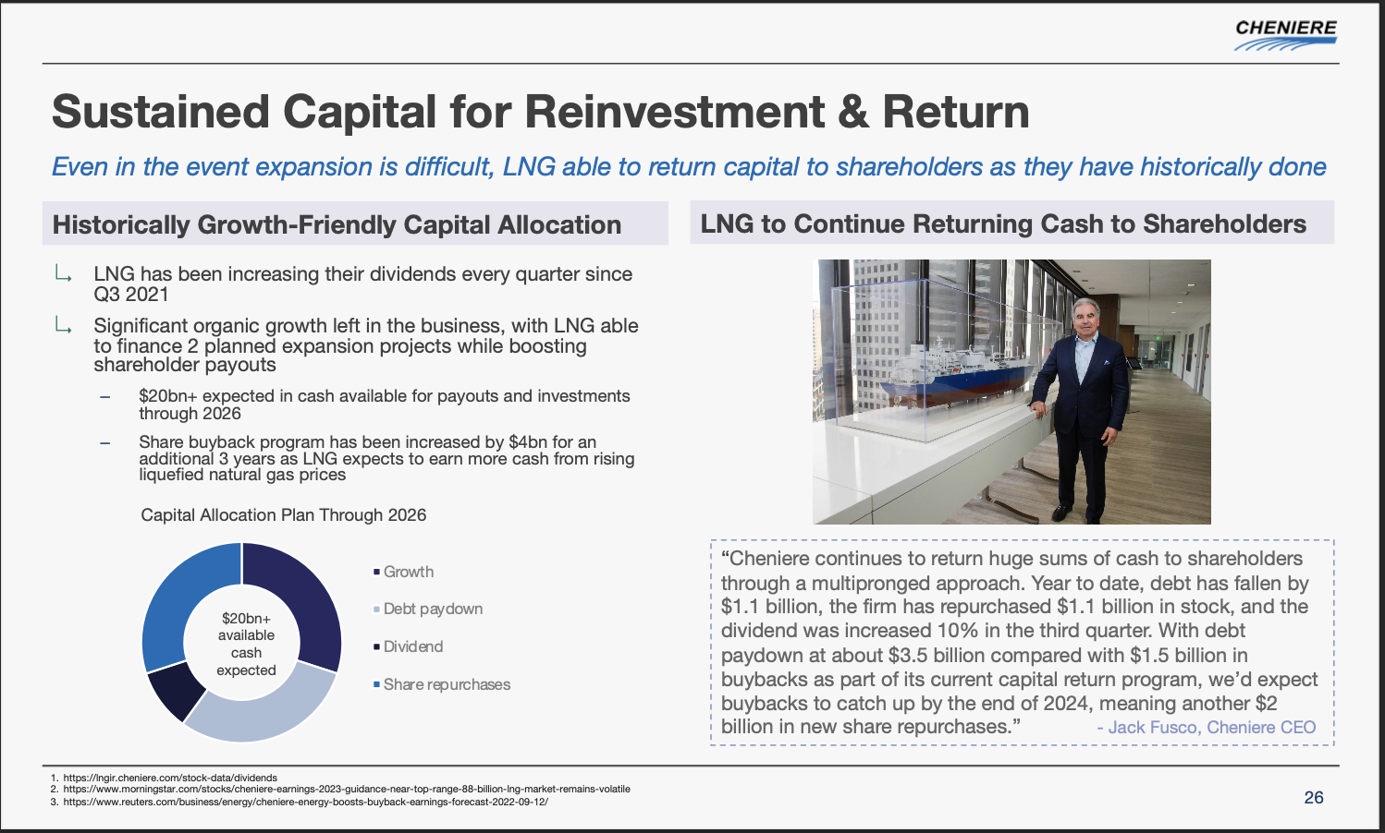
Sustained Capital for Reinvestment & Return

Slide 2
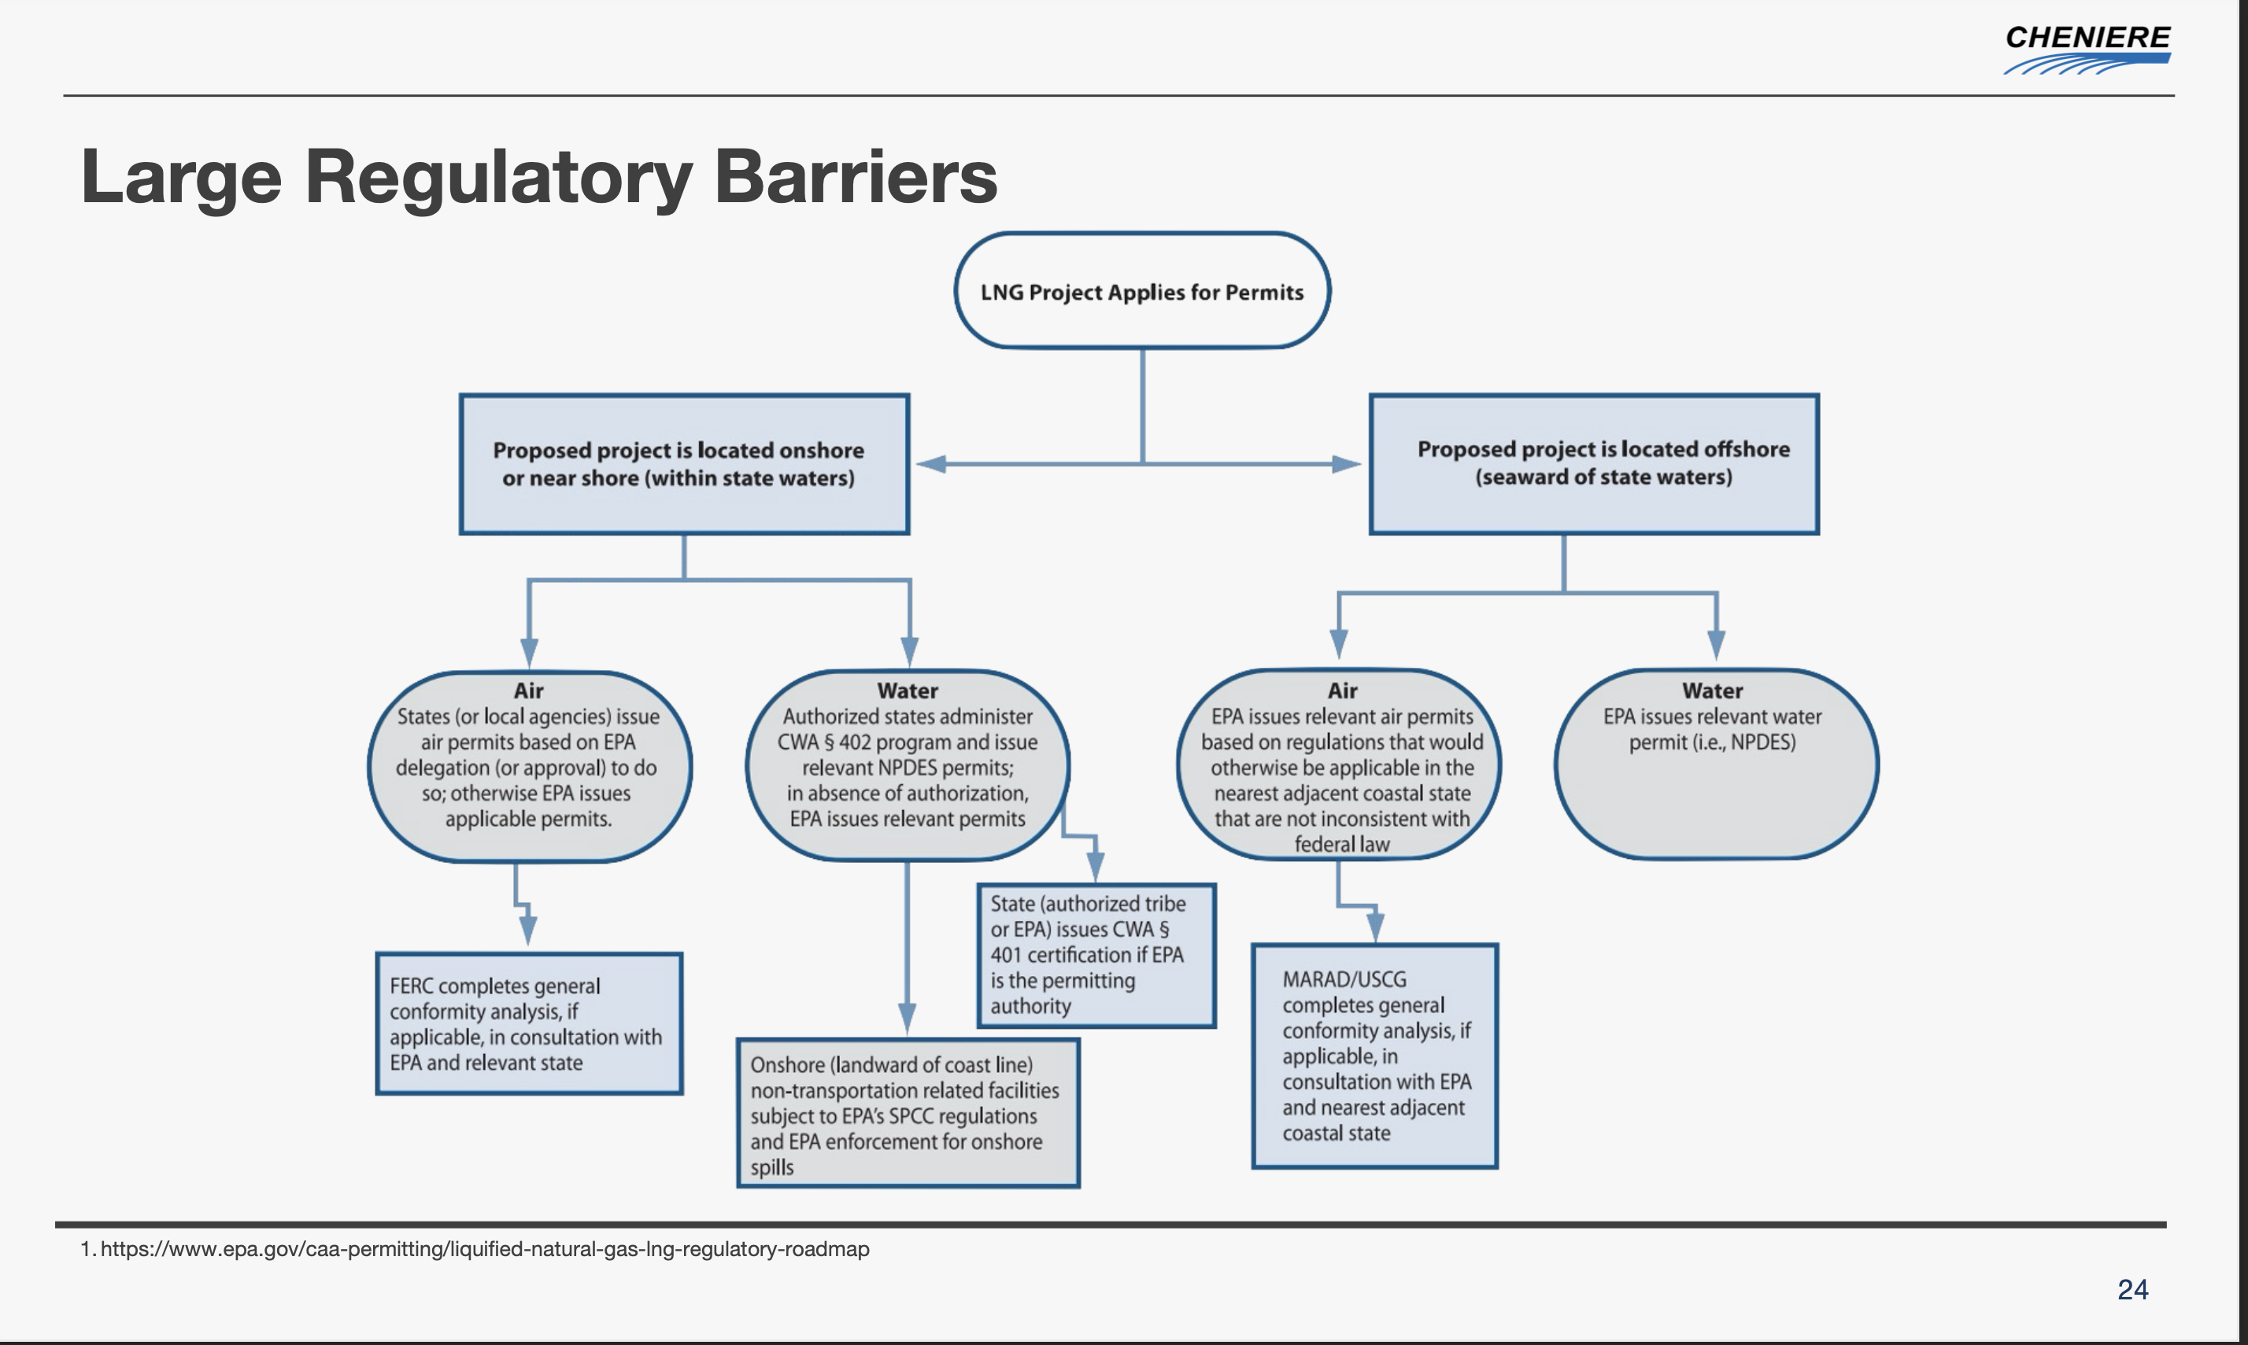
Large Regulatory Barriers

Slide 3
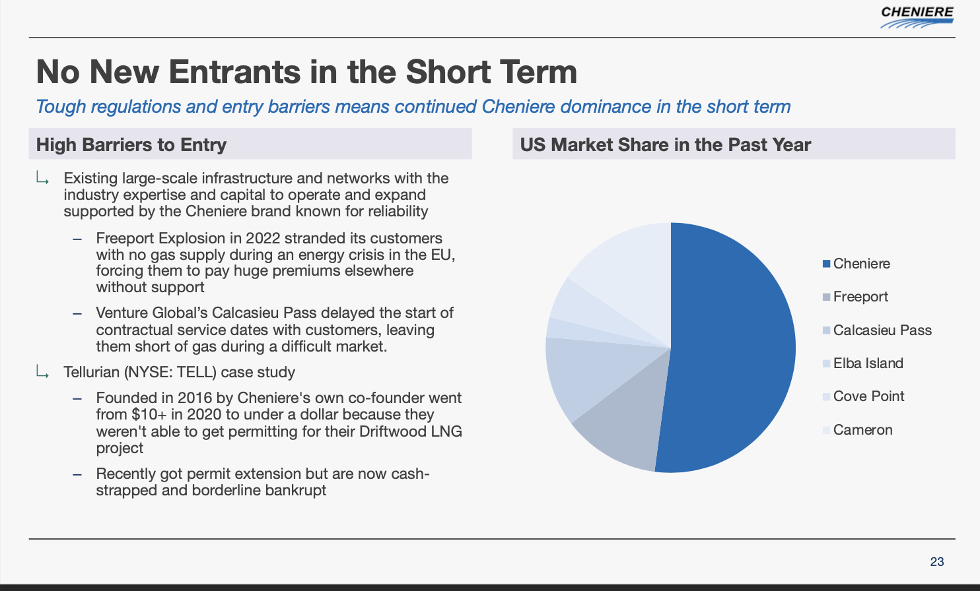
No New Entrants in the Short Term

Slide 4
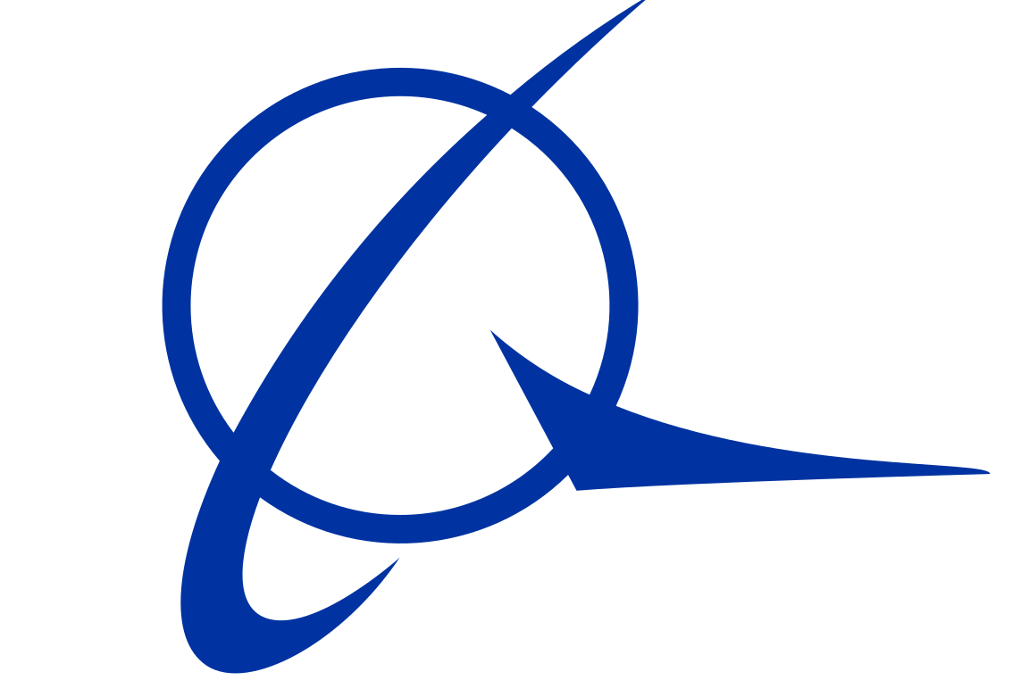

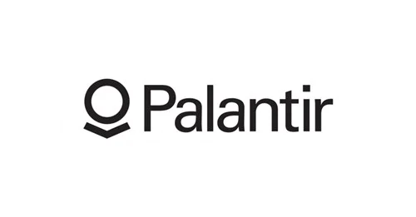
Realization of global trends
The same global trends that have rapidly increased IonQ’s addressable market have not been recognized in its value while they have for competitors.
Time Related Switching Costs
Relative Industry Company Valuations
The AI boom has relatively driven valuations for a lot of related quantum computing or hardware related stocks in hopes that the they hold potential value creation through Artificial Intelligence
These trends are clearly increasing the addressable market with more and more firms wanting to associate with IonQ, but that value is definitely not reflected in its stock which is trading at pre-GPT levels virtually.
IonQ beat revenue earnings earlier this year, which only adds to the fact that the market is clearly
Psi Quantum is valued at ~$3bn for the potential it holds in quantum computing when it is virtually still a research aspiration.
Post GPT Palantir has soared ~200%, like many intensive firms.

Slide 5
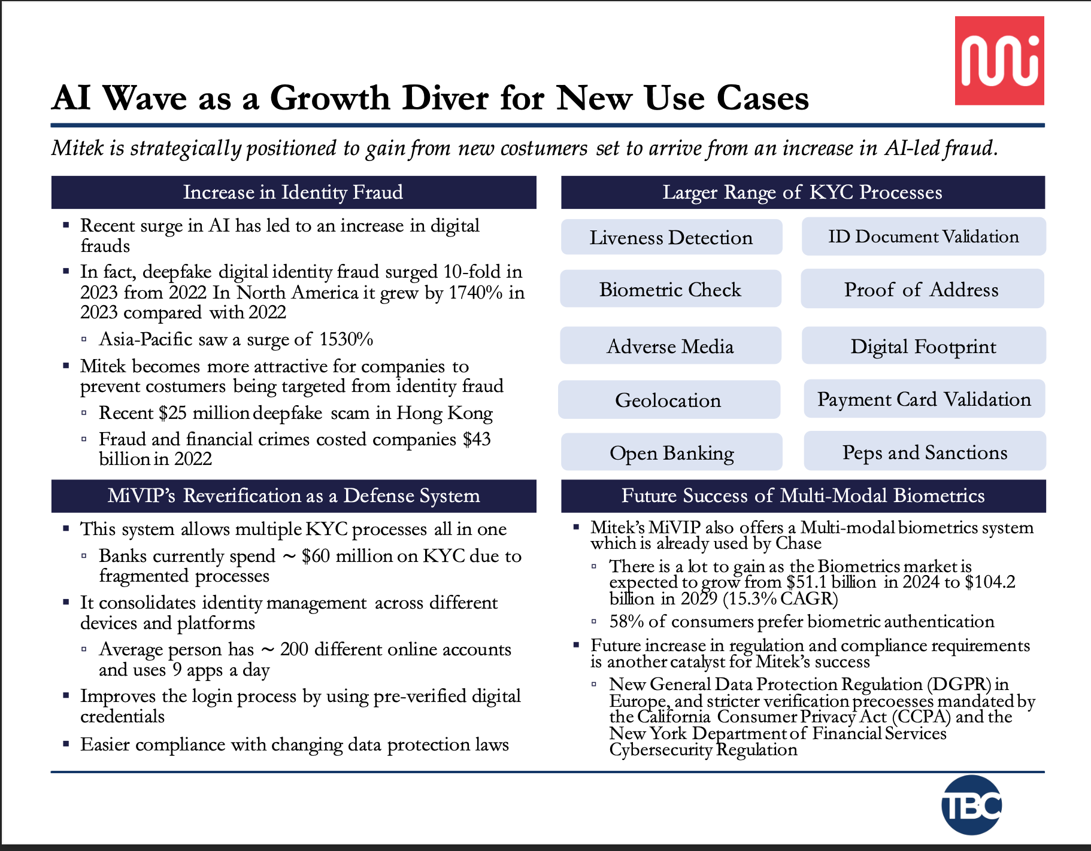
AI Wave as a Growth Driver for New Use Cases

Slide 6
Income Statement (Base Case)

Slide 7
Balance Sheet (Base Case)

Slide 8
Cash Flow Statement (Base Case)

